Slide 1
Survival Analysis of a Patient
Diagnosed With Prostate Cancer
Rashi Desai
663553314

Slide 2
Survival Analysis of a Patient Diagnosed With Prostate Cancer
Predict for a dataset if a patient survived after 7 years of diagnosis
Training dataset containing 15,385 records; predict 11,531 records of test data
Dependent variable: Variable 33: survival_7_years (a binomial variable [1, 0])
26 continuous variables, 7 characters

Slide 3
Approach
Data type conversions (Numeric <-> Factor)
Create derived variables
Remove insignificant variables using
subject matter expertise
correlation plot
Build a binomial Logistic Regression model on the training data
Use the model to predict the test data

Slide 4
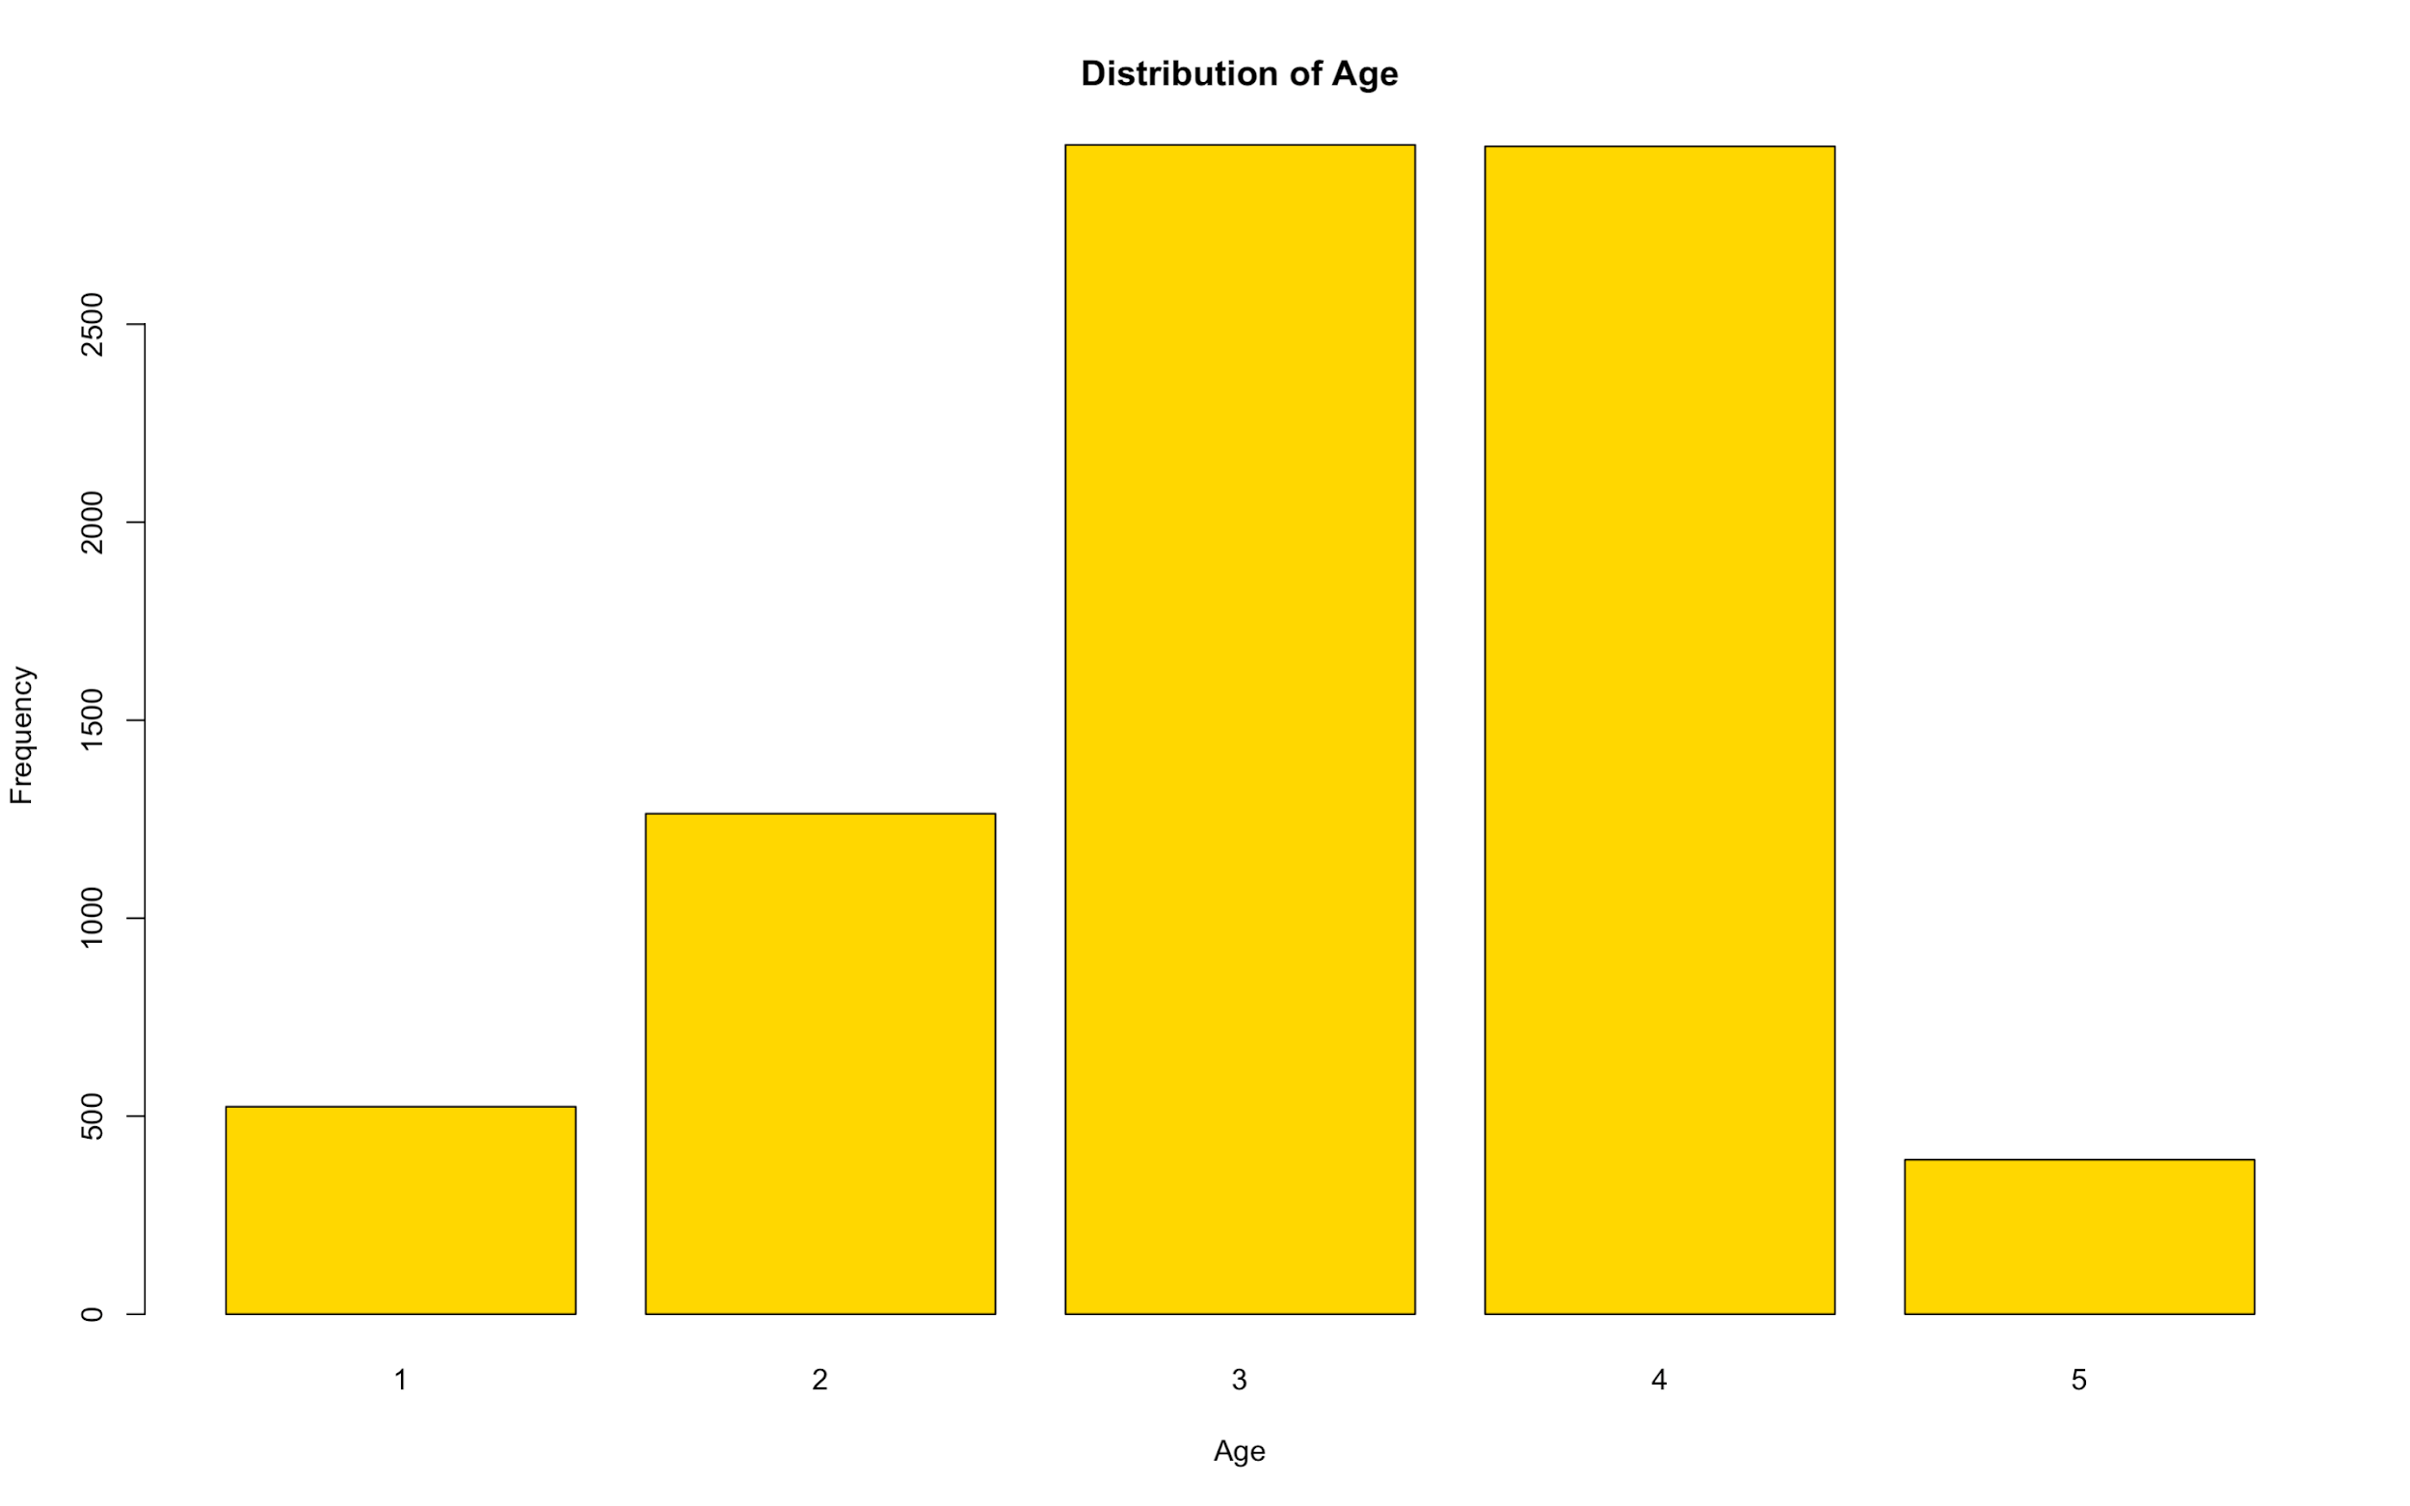
Data Preparation
Men who drank >=7 cups of tea daily had a 50% higher risk than men who drank three or fewer
Bins for tea:
<3 cups - 0
3 - 7 cups - 1
7+ cups - 2
Converted numeric fields to categorical
Removed NAs from the entire dataset: 8955 observations remain
Created bins for age:
<60: 1 | 60-70: 2 | 70-80: 3 | 80-90:4 | >90:5
numeric → factor

Slide 5
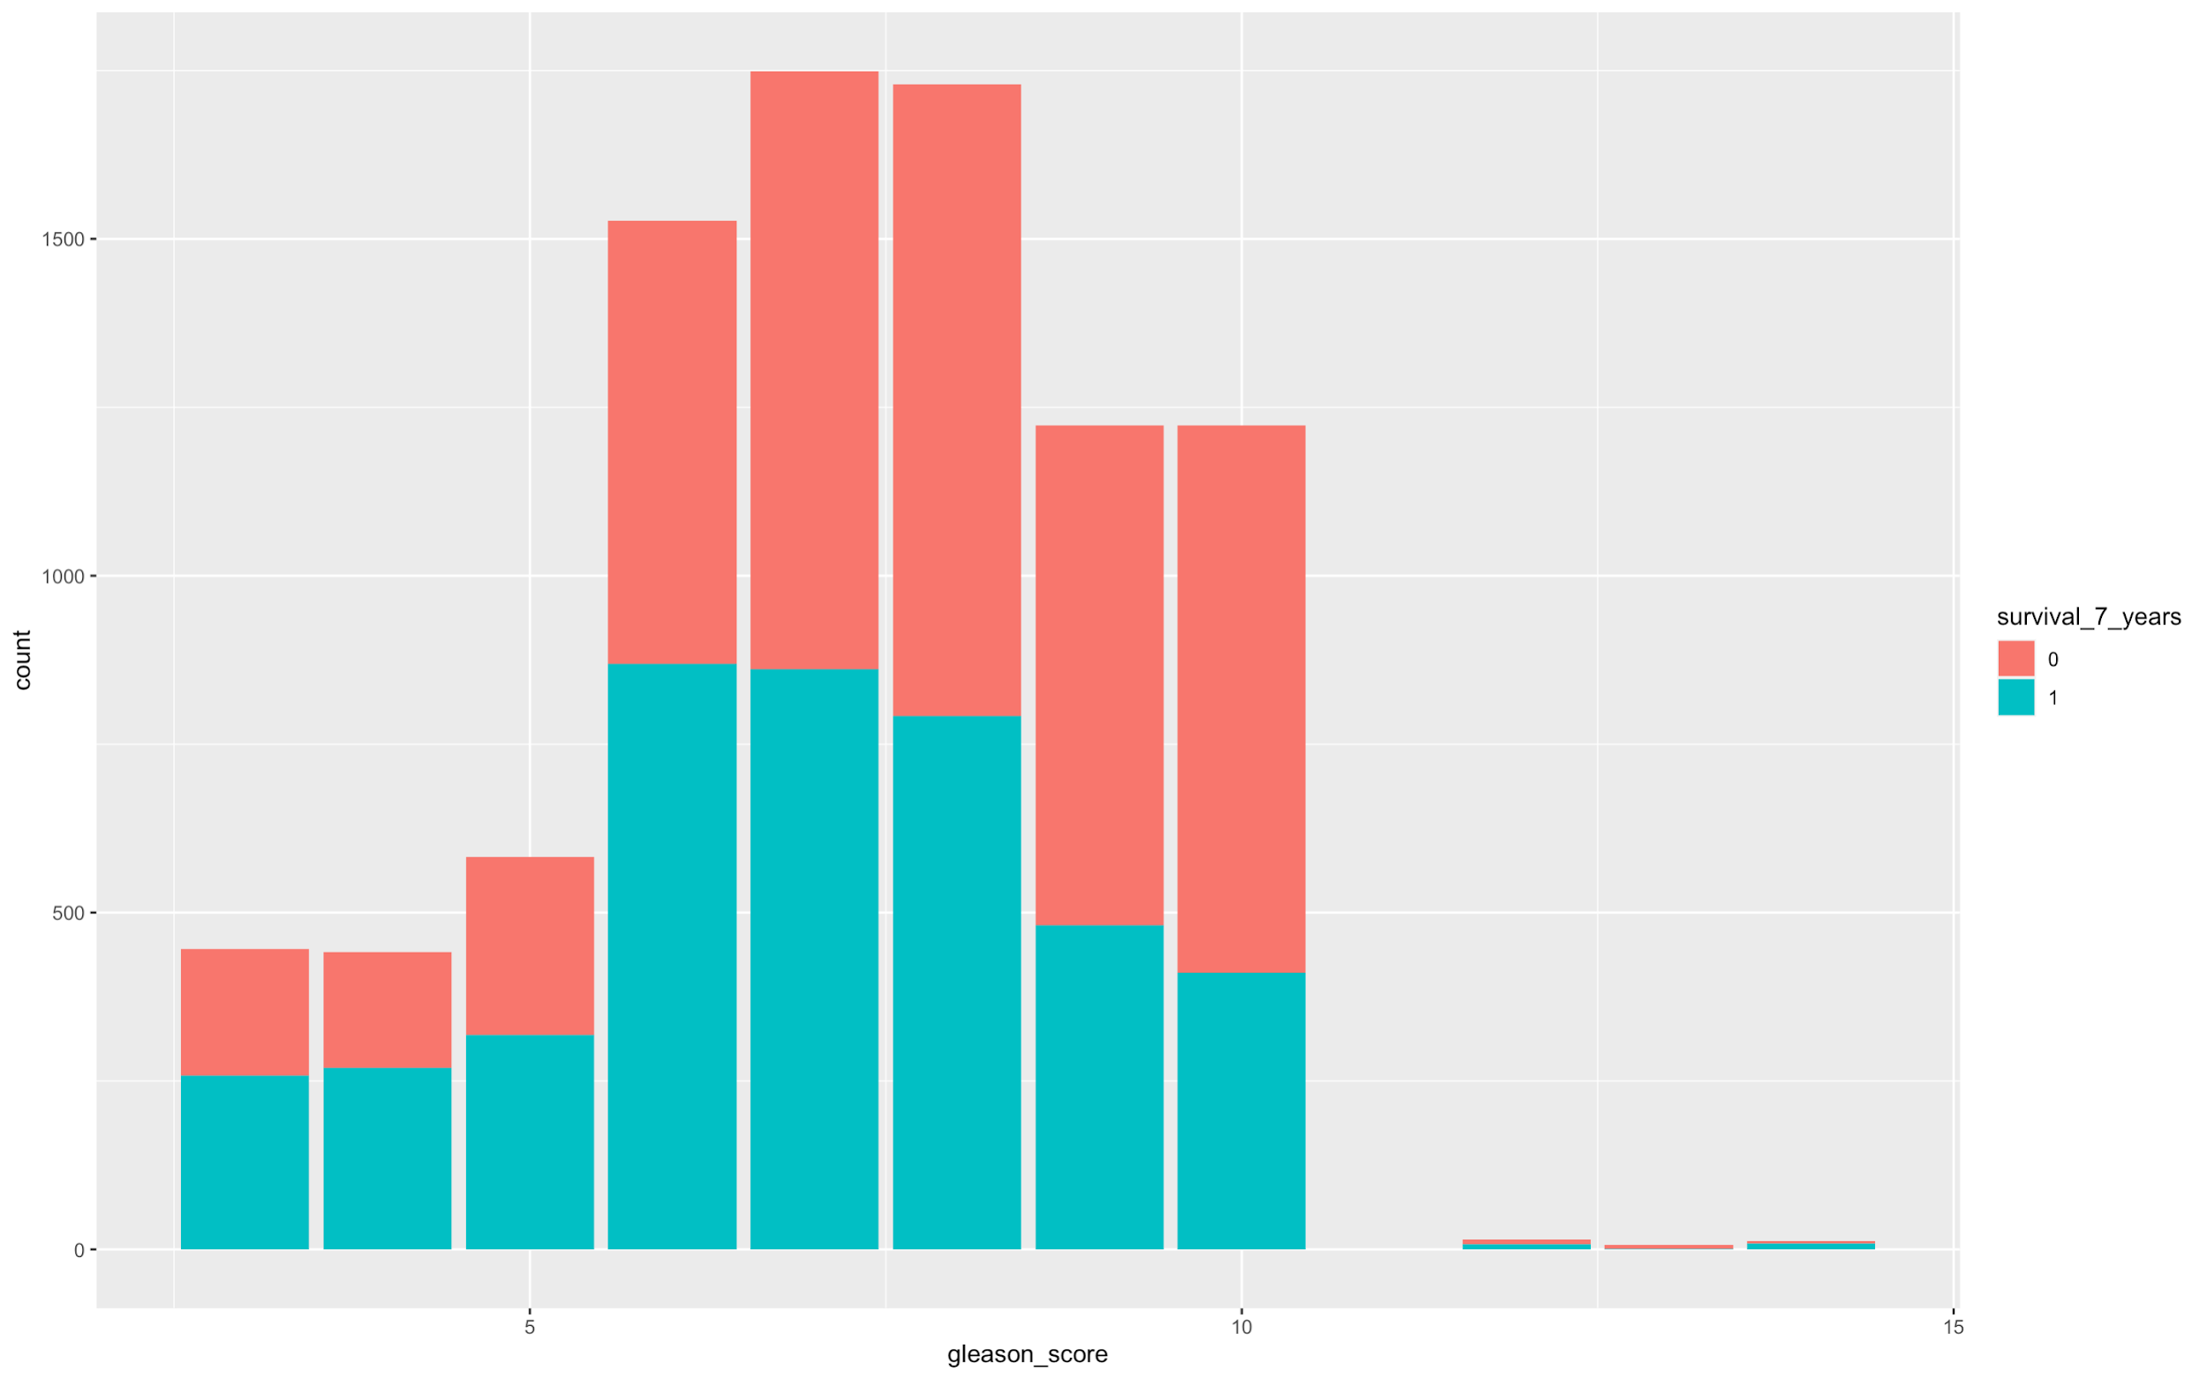
Univariate Analysis
From the graph, we see that patients with high gleason score do not survive after 7 years of diagnosis
The lowest gleason score reported on a prostate cancer biopsy is 6
Bins for gleason score:
gleason score <6 : 1
gleason score = 7 : 2
gleason score = 8 : 3
gleason score 9-10: 4
gleason score 10+ : 5

Slide 6
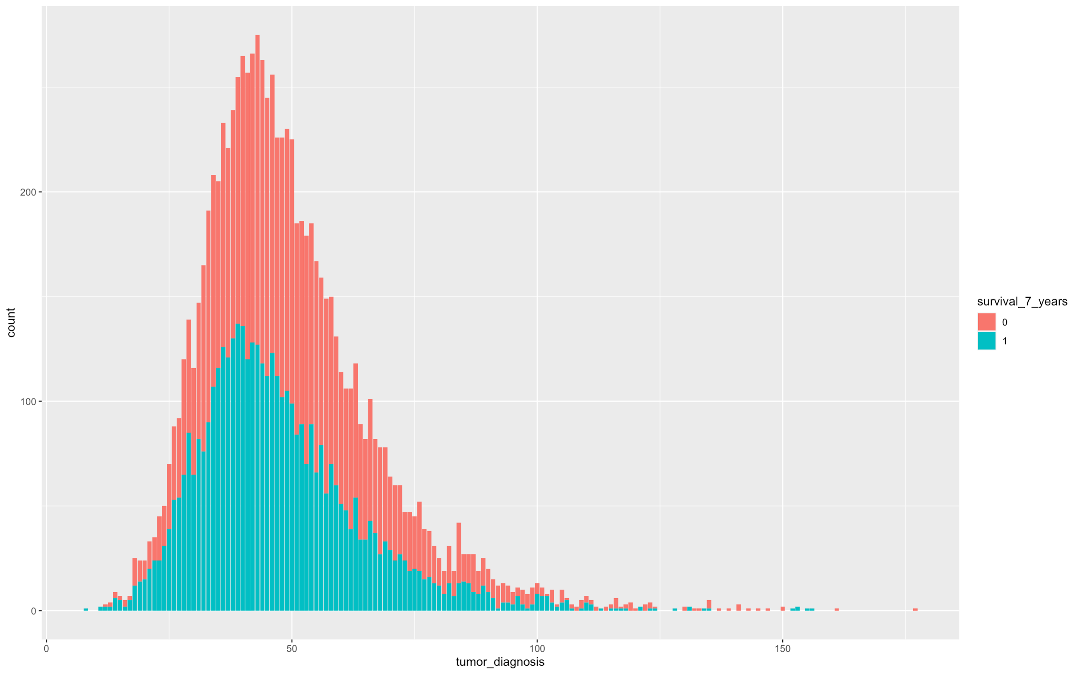
Univariate Analysis
From the tumor_diagnosis graph, we can see that the patients who do not survive after 7 years had a bigger tumor compared to people who survived

Slide 7
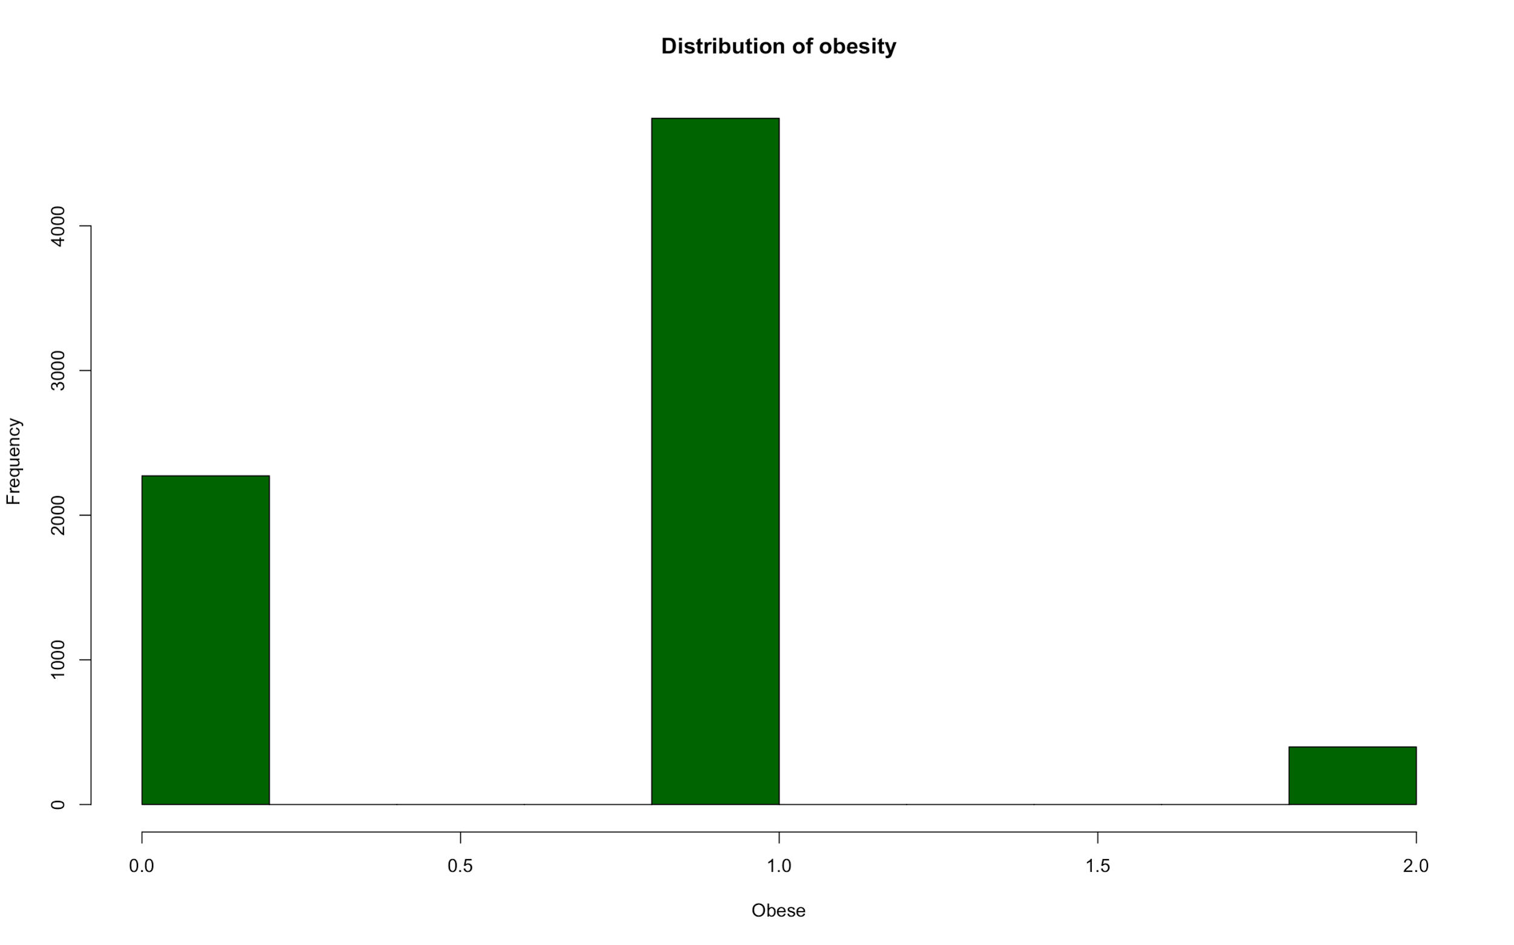
Derived Variable
22 Factors; 9 continuous and 2 characters
For overweight men, the risk of prostate cancer increases by 8%, obesity increased the risk by 20% and severe obesity boosted it by 34%
Height & weight: BMI = 0.45455*weight/(.0254*height)^2)
BMI < 25: Normal
BMI between 25 - 30: Overweight = 1
BMI > 30: Obese = 1

Slide 8
Conceptual Model
Risk Factors
Age
Race
First-degree-history
Family history
Indicators of aggressive risk
t_score
n-score
m_score
Other variables
tumor_diagnosis
rad_rem
tea
symptoms
smoker
obesity
previous_cancer
side
High Risk Indicators
Stage
Gleason Score
PSA Diagnosis
Therapies undergone
rd_thrpy
h_thrpy
chm_thrpy
cry_thrpy
brch_thrpy
multi_thrpy

Slide 9
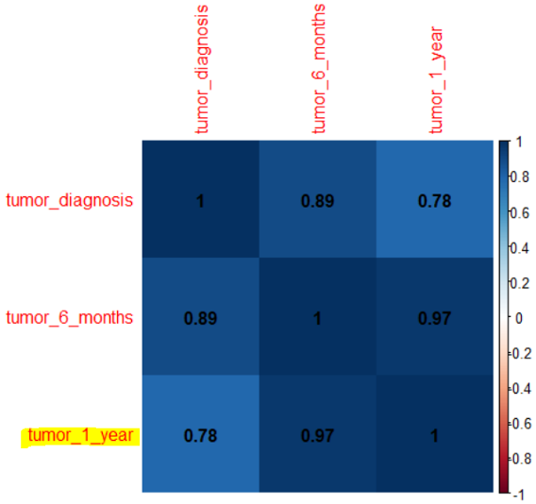
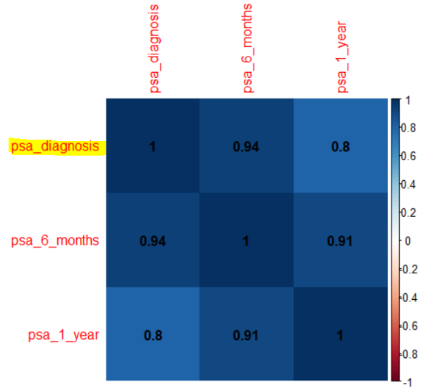
Variable Treatment
Variable: Symptoms
There were 16 different symptom codes in the column
Created columns for each symptom code as binary: 0 and 1
Performed chi-square test to determine what symptom codes are significant: U05, P01, P02, P03
Removed by variable importance: id, diagnosis_date
Removed by Chi-squared test: previous_cancer, h_thrpy, brch_thrpy, rad_rem, side, obese
Removed by correlation tumor_diagnosis, tumour_6_months, psa_6_months, psa_1_year
Notes:
Did not remove smoker because smokers had high chances of death, not getting the cancer though.

Slide 10
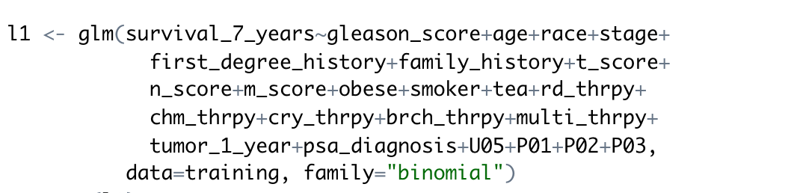
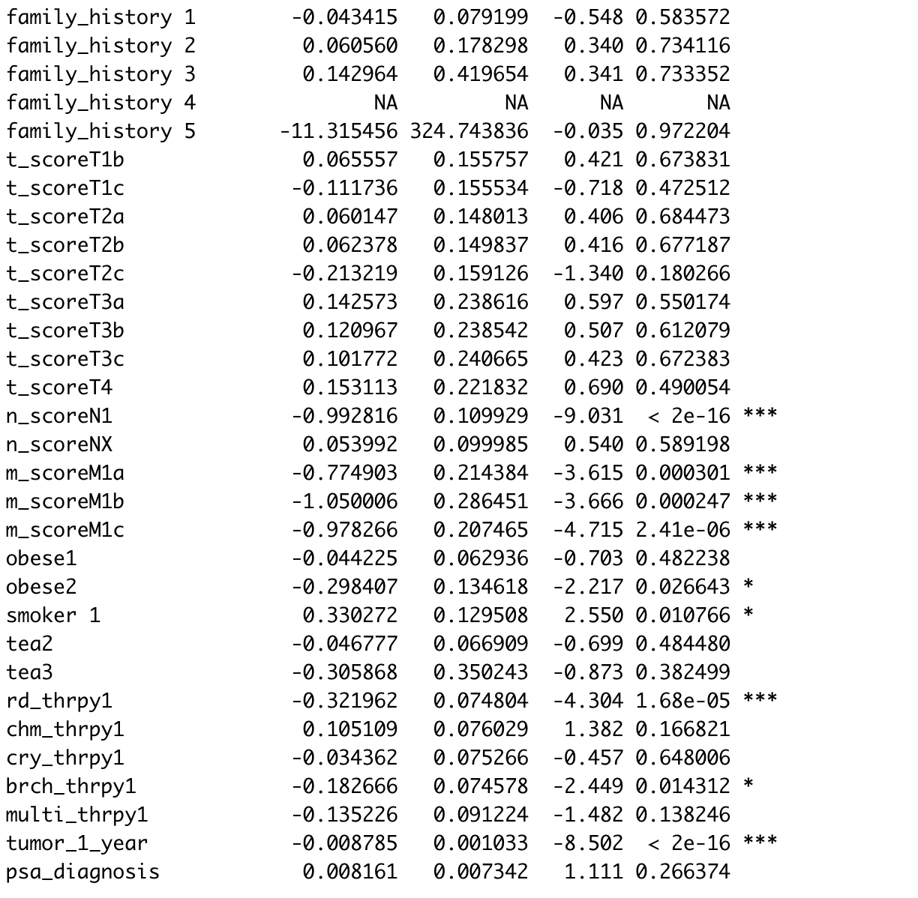
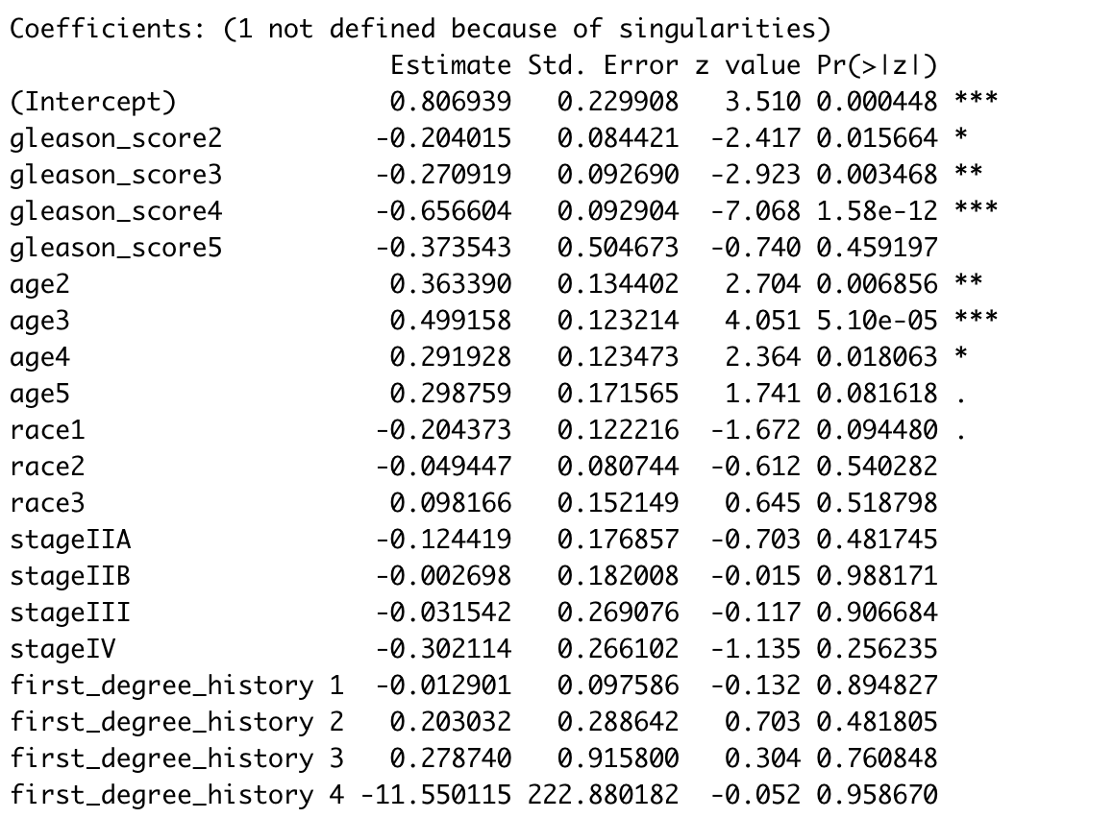
Logistic Regression
*
Notes:
RELEVEL on Model on 24 variables

Slide 11
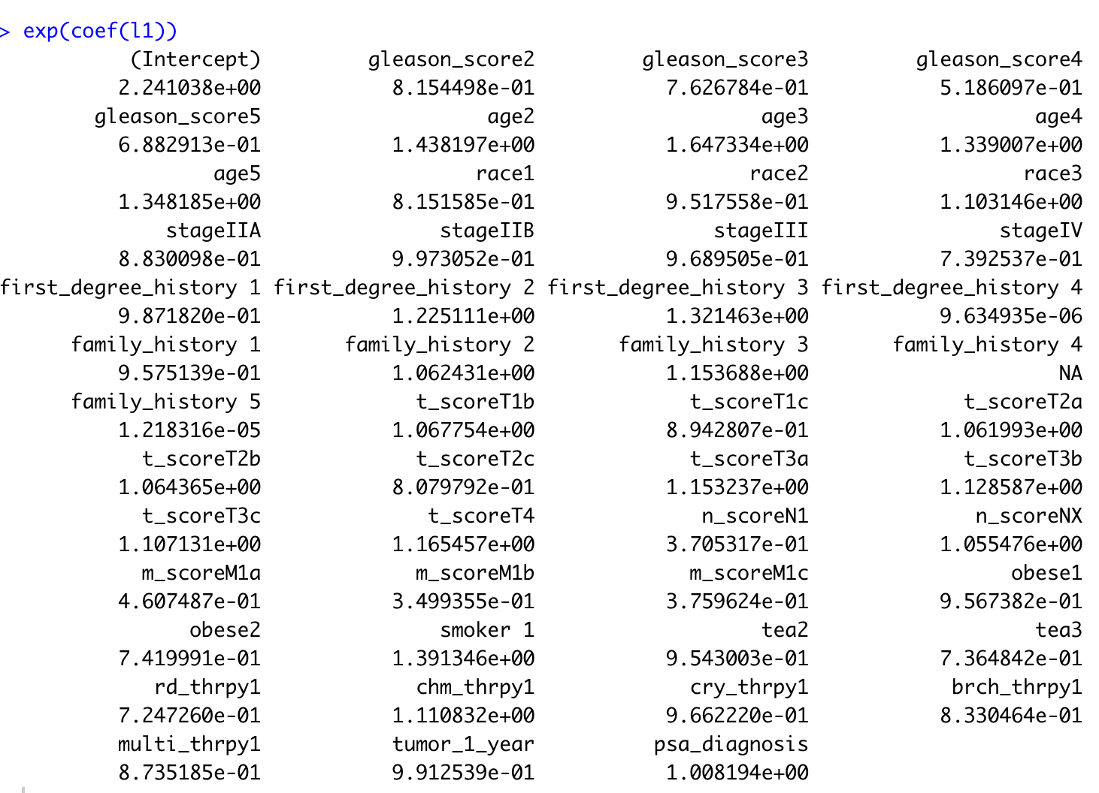
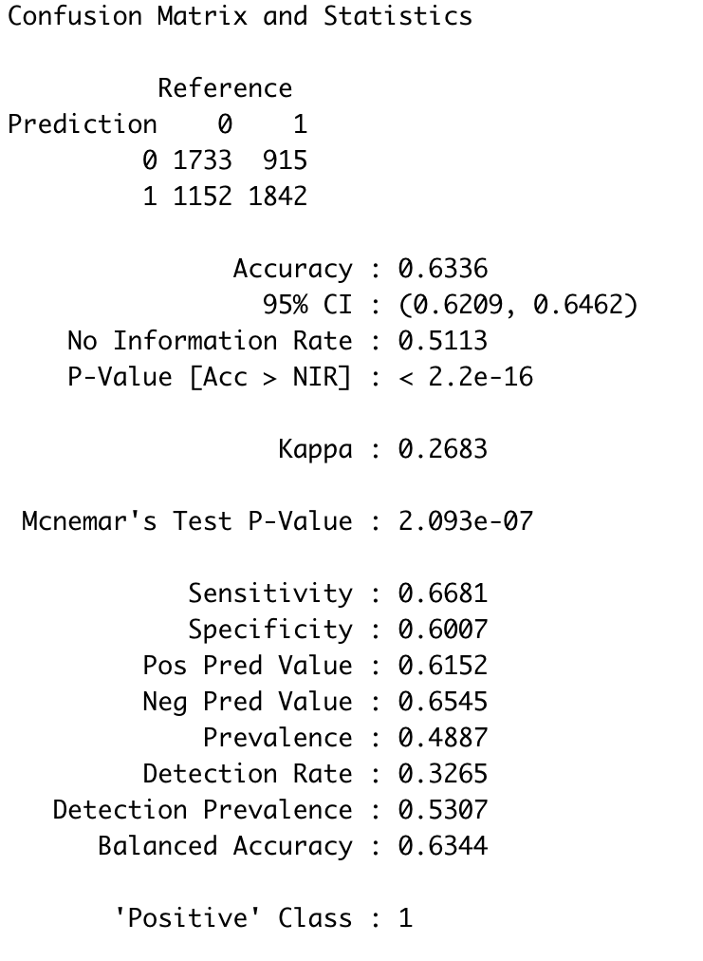
Log Odds Ratio

Slide 12
Predictions on Test Data
Result | Value | Number of records | % of test population
Patients who survived | 1 | 5330 | 46.22
Patients who didn’t survive | 0 | 4196 | 36.38
No prediction | NA | 2006 | 17.39
Patients with the following conditions are less likely to survive:
Gleason score of 8-10
Age between 70 - 80 years
N1 score (The cancer has spread to the regional (pelvic) lymph nodes)
Metastatic prostate cancer (M1a, M1b and M1c)
Stage IV: The cancer has spread beyond the prostate
Tumor detected in the past one year

